Slide 1
Intelligence-Driven
Digital Risk Protection

Slide 2
2010
Hello, we are Cyberint
We turn intelligence into actions to effectively and proactively protect your business
2010
One of the first threat
intelligence companies in Israel,
founded in 2010
+70 Experts
National level intelligence
experience
Fortune 500
Fortune 500
customers
Technology
Argos™ - Proprietary robust Threat Intelligence Platform
Managed Service
Overlaying the technology - providing expert support to gain additional value
Worldwide
Offices in USA, UK, Israel,
Philippines and Singapore
Confidential | Cyberint Copyright © All Rights Reserved 2020

Slide 3
Cyberint Mission Statement
We provide Comprehensive Digital Risk Protection
by turning Intelligence into Actions
resulting in Effective and Proactive cyber defense

Slide 4
Protection Outside the Perimeter
SOCIAL MEDIA
EMPLOYEES
Ransomware
Your
Organization
Fraud
DEVELOPMENT ENVIRONMENTS
Credential collection
DATA
Phishing
Account Takeover
CUSTOMERS
THREAT ACTORS
Credentials, PII,
Sensitive data
APPS
PAYMENT PLATFORMS
MARKETING SITES

Slide 5
Collective Perspective from Cyberint Customers
on the reasons Intelligence-Driven Digital Risk Protection is important to them
Strategic
Illustrating the risk to the board and management in an optimal way
Knowing which reference threats should be considered for a proper security defense architecture (identify intent, techniques and tools)
Identify and continuously monitor digital exposure that can be exploited by cybercriminals
Detect breaches as they occur and propagate outside the organization’s perimeter
Gain visibility into attacks targeting your brand and customers evolving outside of your network
Remediation of ongoing threats (Fraud, Phishing)
Operational
Notes:
Phishing
Brand abuse/reputation – fake malicious apps, customer credentials stolen, …
Coupon fraud, …

Slide 6
Cyberint Offering

Slide 7
Cyberint Offering
Argos™ Technology
Managed Service
Threat Intelligence
Dark Web Monitoring
Attack Surface Mapping
Forensic Canvas
Phishing Detection & Takedown
Targeted Monitoring
Virtual HumINT
Deep Investigations
Threat Landscape Analysis
Notes:
this is the optimal combination of product and services

Slide 8
Argos™ Intelligence Lifecycle
ATTACK SURFACE MONITORING
COLLECTION
& INDEXING of RAW INTELLIGENCE
INVESTIGATION,
ANALYSIS
DISSEMINATION & REMEDIATION
Ongoing discovery of new assets
Mapping of exposure
Digital asset exposure scoring for risk management
Addressing cloud challenges
Ongoing collection and indexing from Open, Deep and Dark-web sources
Collection of more than 1.3M raw intelligence items per day
Covering >1,800 sources from multiple platforms
>300 new sources added every year
Attribution, classification & prioritization of raw data against the organization’s assets
Forensic Canvas for advanced investigations and threat actor analysis
Covering >75 types of alerts type
Rich, contextualized alert reports
API access for easy integration
Ability to interact with Cyberint’s analysts
Phishing sites takedowns request
Notes:
Intelligence challenges begin with understanding what assets you should be looking after
[Typical customers have 10-20 new assets discovered every quarter]
Our detection rate is over 10x that of Shodan, giving our customers a window of opportunity to close before exposure is published
Identification of open storage buckets to identify information exposure, abandoned/hijackable subdomains and attribution of leaked API tokens based on integration

Slide 9
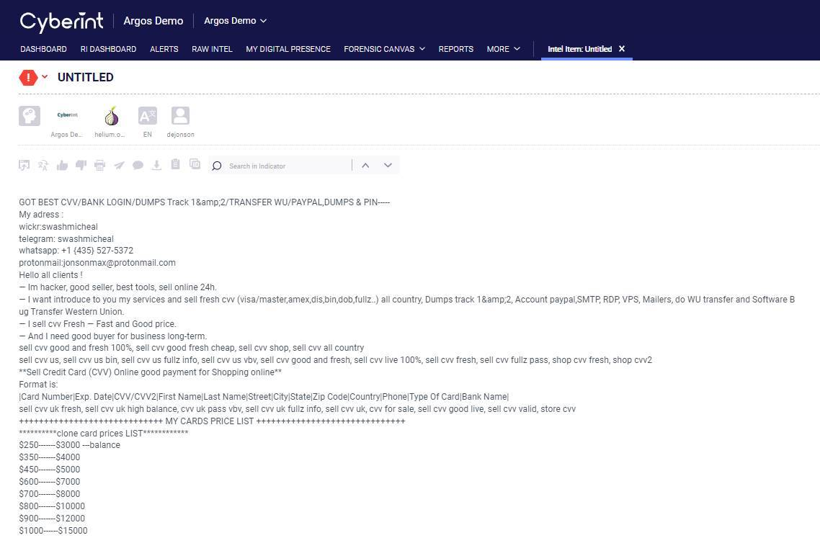
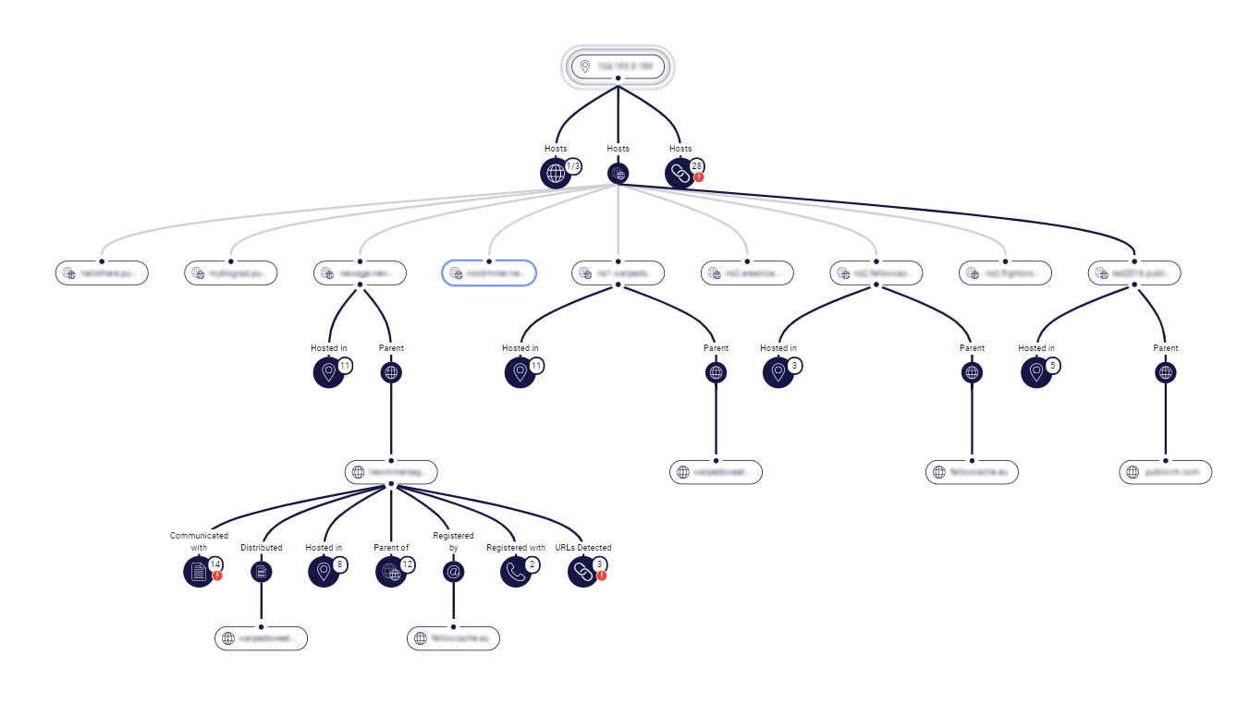
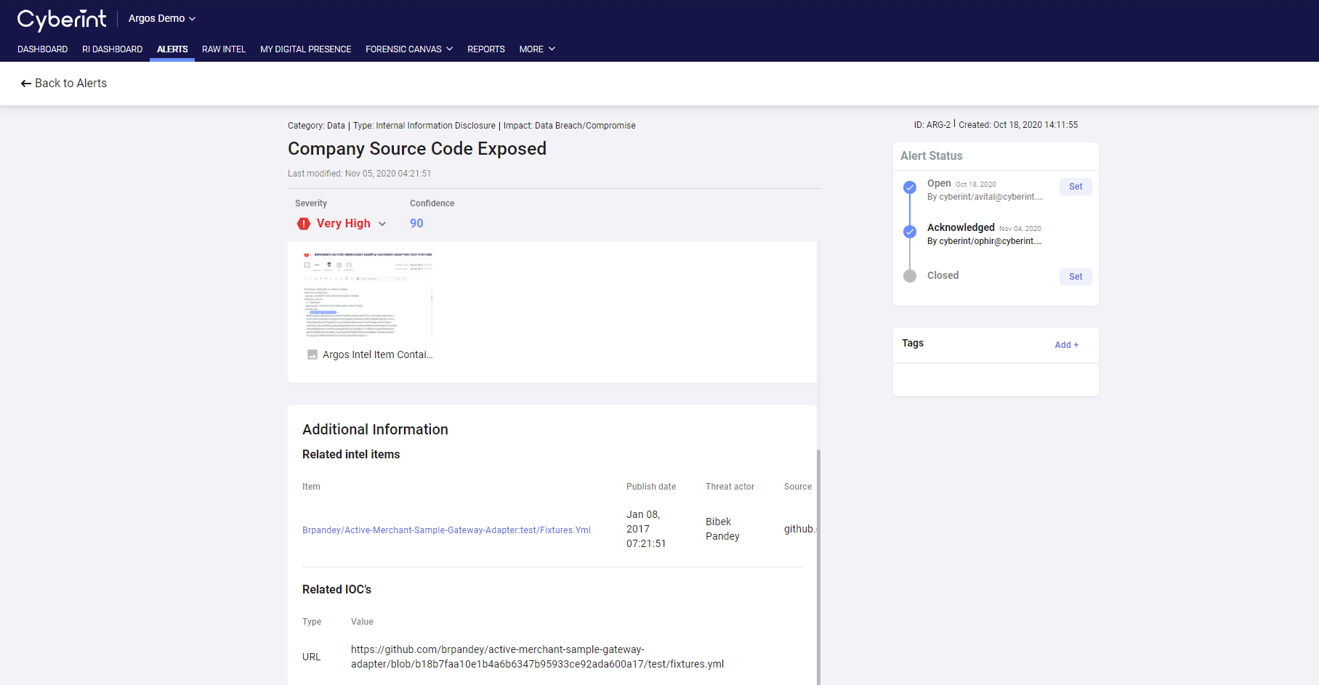
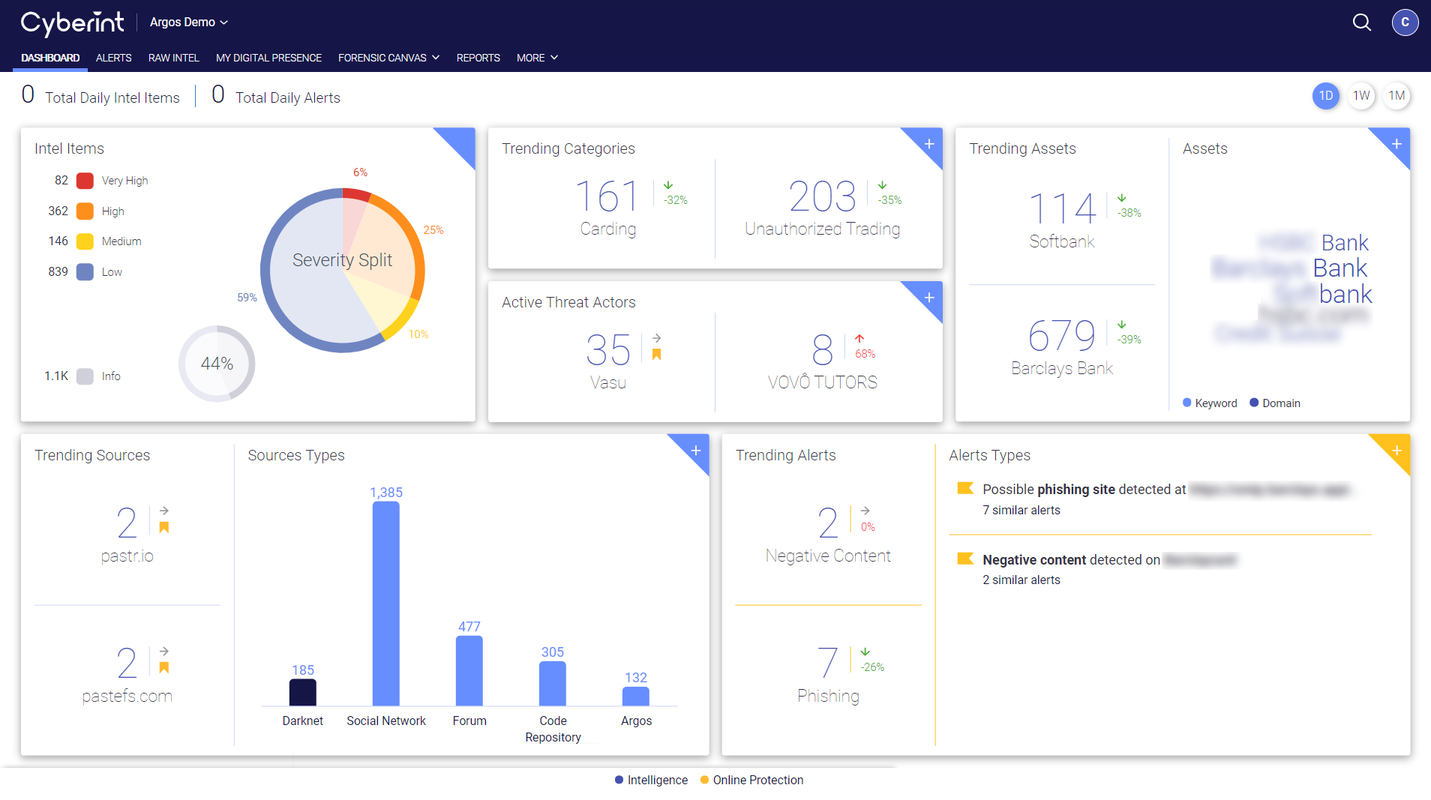
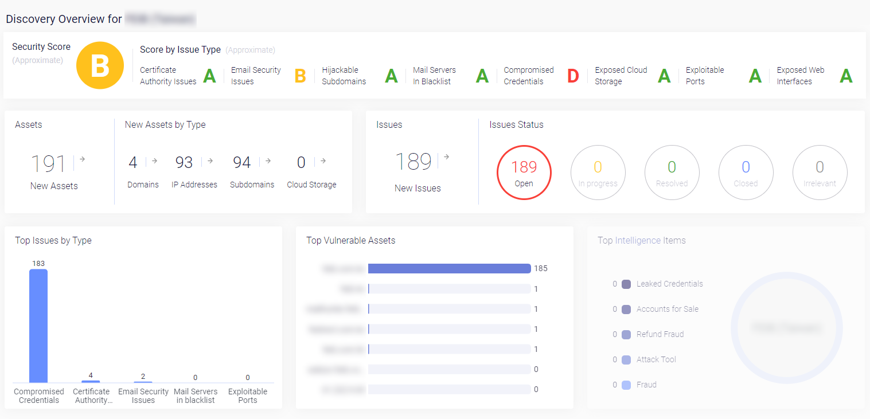
Argos™ Intelligence-Driven Digital Risk Protection Platform
Attack Surface Monitoring
Raw Dark-web Intel Collection
Alert Creation
Threat Intelligence Overview
Forensic Canvas

Slide 10
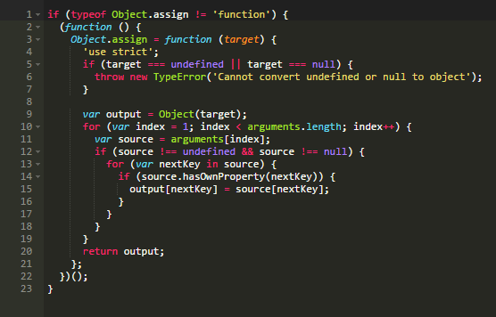

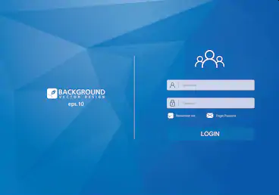
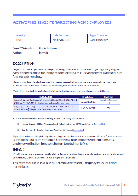
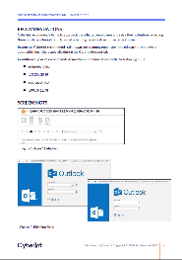
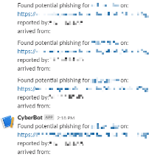
Cyberint Phishing Beacon
Advanced Phishing Detection for Digital Businesses
Adding code to the relevant pages
Attacker replicates
one of these pages
The replicated page
is accessed
Alert is sent & Takedown Initiated
Investigation to provide verified and contextualized information
Argos™ detecting the domain hosting the replicated page
Notes:
The potential damage of a successful phishing attack to an organization is huge and influences security operations, brand reputation and data privacy regulations. The average cost of a phishing attack to a mid-size company is 1.6 million dollars, for larger companies the average cost is increased to 3.7 million dollars. (source: https://blog.dashlane.com/phishing-statistics/)
Success story with an internet company in the US where after few month of engagement +80% of the phishing websites detected by this method

Slide 11
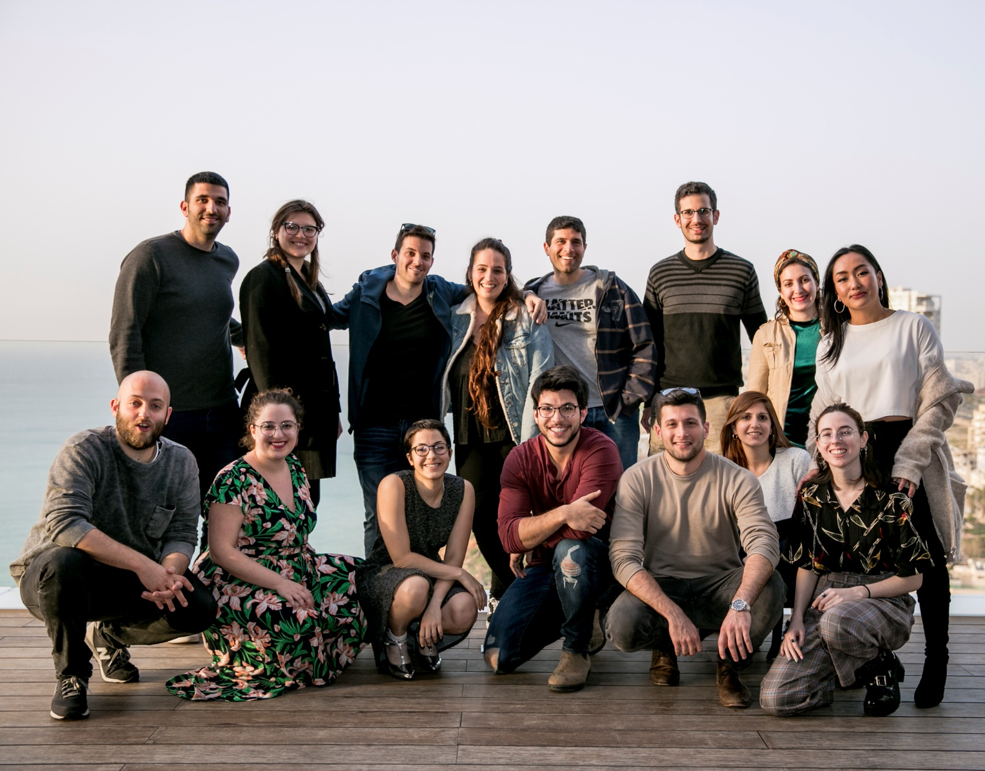
Managed Service
INTELLIGENCE ANALYSTS
TI, SecOps and Fraud team's augmentation
Ongoing coverage and analysis
Business Aware dedicated analysts
Multilingual team
CYBER OPS
Interacting with threat actors on their turf to gain additional context
Virtual HumINT Operations
Sample acquisition of threatening data to quickly neutralize it

Slide 12
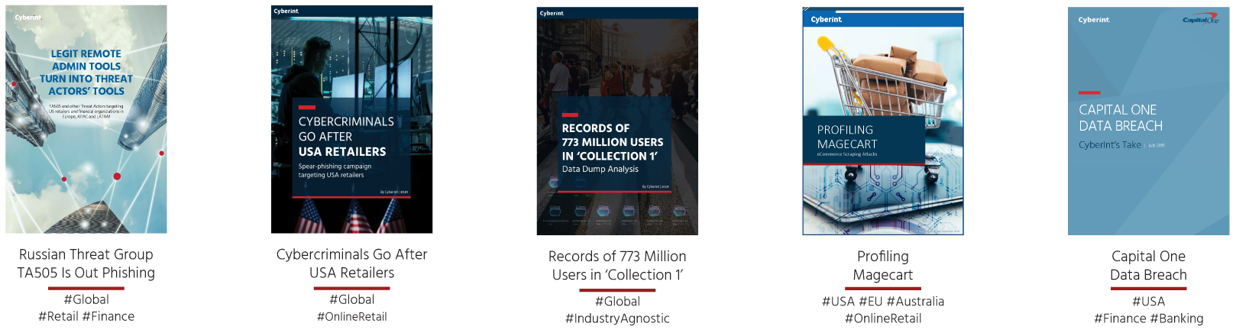
Managed Service
RESEARCH LAB
Investigating adversary tradecraft and TTPs focusing on threats and industries globally and across regions

Slide 13
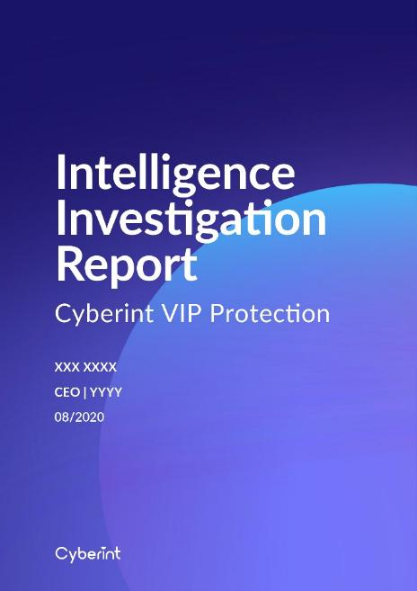
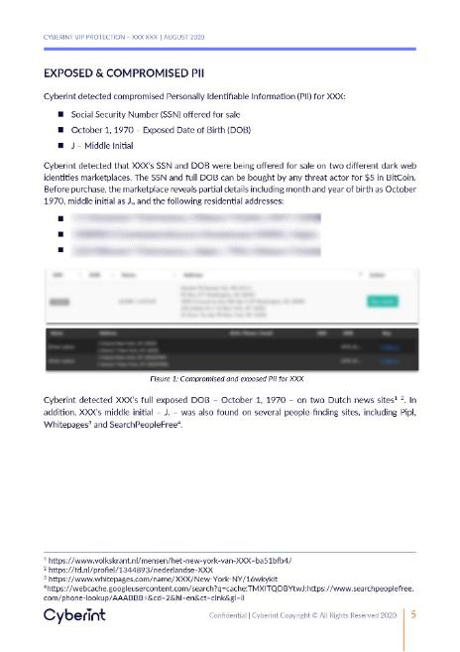
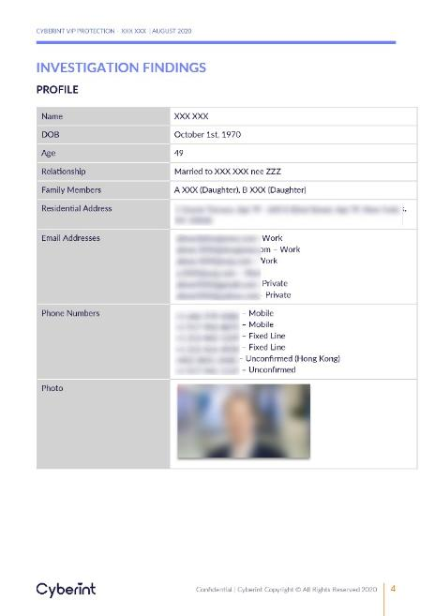
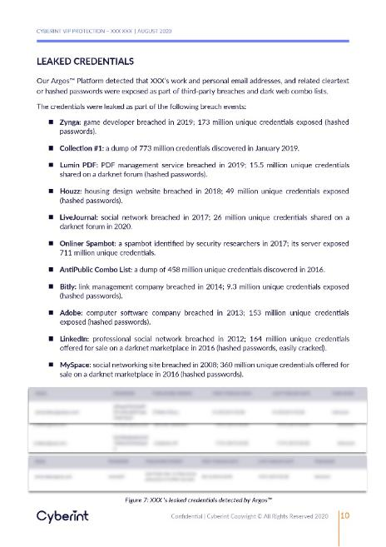
VIP Digital Protection
VIP'S - A LUCRATIVE TARGET
  Phishing Campaigns
  Competitive espionage
  IP theft
  Intelligence gathering on your planned road map
  Mergers and acquisitions
Identify intrusions into your VIPs’ accounts, and any compromise of their valuable data
Notes:
-building resilience and improving cyber threat intelligence program
-protects external facing individuals with high digital exposure
-we see a fit for media companies, such as news and entertainment, as well as banking VIP’s

Slide 14
Intelligence Items
Turning into Actionable Alerts
40,000,000 Raw intelligence Items Retrieved during a month – everything is collected
Argos™ PLATFORM
10,539 Related to the organization
Attribution
299 High Confidence
Classification and prioritization
16 Generated Alerts
Actionable. Contextualized. Verified.
MANAGED SERVICES
6 Cyber Operations
Takedowns, Threat Actor investigations
Notes:
40,000,000- collected over a month
cant resolve
false
repetitive intelligence
not an interest
not relevant

Slide 15
Use cases
Confidential | Cyberint Copyright © All Rights Reserved 2020

Slide 16
Addressing a Variety of Business Cases
FRAUD
PHISHING
ATTACKWARE
Mitigate fraud to ultimately reduce your fraud rate
Promote preventive initiatives and awareness
Ensure ongoing and continuous visibility
Refund Fraud, Carding,
Coupon Fraud, Money Laundering, Victim Reports, Malicious Insider, Extortion
Phishing Email, Phishing Kit,
Phishing Website, Lookalike Domain, Phishing Target List
Malicious File, Reconnaissance,
Automated Attack Tool,
Business Logic Bypass, Target List
BRAND
DATA
VULNERABILITIES
Safeguard all facets of your online presence
Improve defense mechanisms
Don't let them exploit
Compromised PII, Compromised Access Token, Internal Information Disclosure, Malicious Insider, Compromised Payment Cards, Compromised Employee Credentials, Compromised Customer Credentials, Ransomware
Exposed Web Interfaces, Hijackable Subdomains, Website Vulnerabilities, Exposed Cloud Storage,
Exploitable Ports, Mail Servers in Blacklist, Server Connected to Botnet, Email Security Issues, Certificate Authority Issues
Official Social Media Profile, Impersonation, Intellectual Property Infringement, Unauthorized Trading, Negative Sentiment, Fake Job Posting, Defacement
Notes:
cant resolve
false
repetitive intelligence
not an interest
not relevant

Slide 17
Case Studies
Confidential | Cyberint Copyright © All Rights Reserved 2020

Slide 18
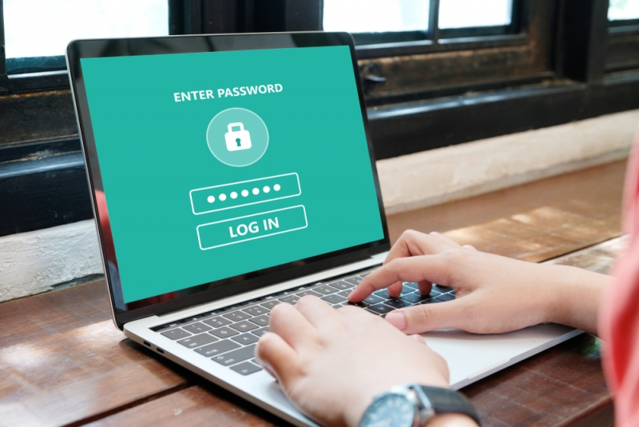
Fresh Credentials are Key
Many of the attacks start by trying to obtain fresh credentials
Once achieved, the hacker can get inside as a legitimate employee
At that stage it is very hard to detect his/her actions
Hackers develop many automatic tools to try to obtain credentials

Slide 19
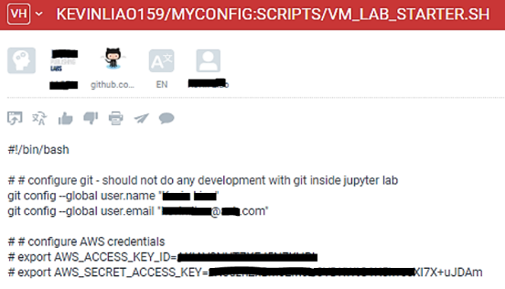
Leaked Credentials Detection
Argos™ Detection
Argos™ is monitoring code-sharing repositories such as Github for leaked employee and customer credentials
Exposed AWS credentials detected including username, user email, AWS access key ID & AWS secret access key
Validation, Enrichment & Investigation
The Github repo was investigated and determined to belong to a legitimate employee who had unknowingly exposed their credentials
Further investigation revealed a third-party bounty hunter and was attempting to extort the retail client
Mitigation & Remediation
Reset credentials on impacted service
Checked for ATO / unauthorized activity in accounts
Takedown of Github repository

Slide 20
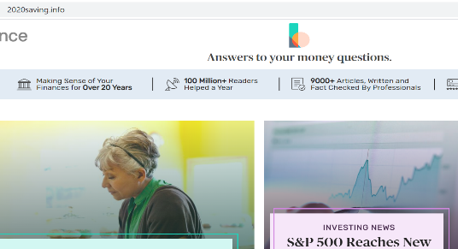

Phishing & Impersonating Site Detection
Argos™ Detection
Phishing technology detected cloned websites of a media company
Attackers started a campaign copying site’s code for malicious intent.
Phishing technology alerted on a domain of 16 copycat sites
Validation, Enrichment & Investigation
Sites were all hosted on same IP, along with dozens of other malicious sites
A related phishing kit was detected containing all web components needed to clone the site
Mitigation & Remediation
Blocked the sites on all endpoint devices and email relay system
Takedown of sites, phishing kit server and
content removal
Employee awareness to phishing campaigns

Slide 21
Asset Discovery & intelligence-led
Attack Surface mapping

Slide 22

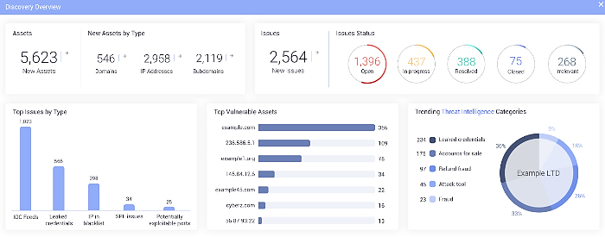
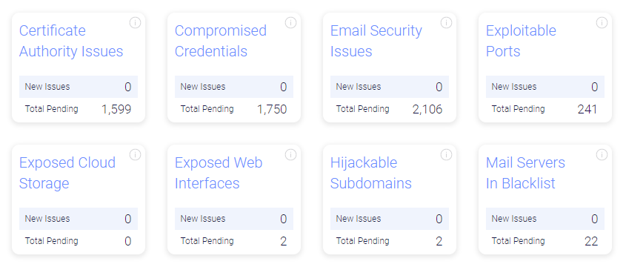
Asset Discovery & intelligence-led Vulnerability Management
Discovery of Digital Assets
Discover your registered IP addresses, Domains, etc
Verify and resolve any shadow assets
Identify Issues/Vulnerabilities
  Automated issues/vulnerabilities correlation
Proactive Protection
  Act on discovered issues
  Re-discover to continuously map new unknown assets
Benefits
  Minimize digital exposure and risks
  Mitigate potential exploits
  Detect shadow assets or misuse of corporate accounts

Slide 23
Refund Fraud Detection & Investigation
Fraudulent Returns on Online Retailer - Virtual HUMINT Operation

Slide 24
Refund Fraud
Virtual HUMINT Operation
vHUMINT
Value
Proactive undercover engagement with Threat Actors to gather intelligence and context during investigation
Assessing veracity and imminence of threat
Obtaining TTPs, motivation, accomplices.
Gathering IOCs for investigation and mitigation

Slide 25
Virtual HUMINT Operation
Refund Fraud
Cyberint client is a large global retail marketplace suffering from fraudulent activity abusing refund policy.
Refund Fraud: Threat Actors defrauding retailers via their return processes (claim goods never arrived, return goods ineligible for refund, etc.).
Business Impact:
  Direct revenue loss to retailer.
  Inventory management process manipulation.
  Negative effect on reputation if publicized.

Slide 26
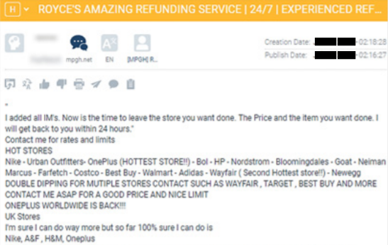
Virtual HUMINT Operation
Refund Fraud
As part of its dark web monitoring for the retailer client, Cyberint detected multiple posts on fraud forums by a Threat Actor (TA) nicknamed “Asclepius”, claiming to have successfully performed fraudulent refunds on several of the largest European retailers. The TA had several other users vouching for his “services” within the forums. Cyberint investigated the TA to create a profile, including activity, partners, etc. and found them to be “legit”.
1
2
3
4
5
6
7
Argos™ Detection
Cyberint Alert & Op Approval
Building Fake Identity
Order Placement & Arrival
Fraudulent Refund Request
TTP & IOC Aggregation
Mitigation

Slide 27
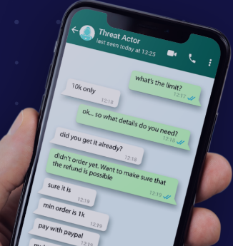
Virtual HUMINT Operation
Refund Fraud
Cyberint then engaged the TA via IM to elicit further details on how the services worked. The TA claimed to have a method requesting refunds through PayPal which always worked for orders above $1,000. The method involved the TA remotely requesting the refund from the partner’s machine, and taking 20% commission if successful. Cyberint advised the retailer to try a test purchase operation and this was approved.
1
2
3
4
5
6
7
Argos™ Detection
Cyberint Alert & Op Approval
Building Fake Identity
Order Placement & Arrival
Fraudulent Refund Request
TTP & IOC Aggregation
Mitigation

Slide 28
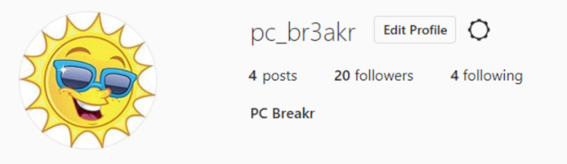
Virtual HUMINT Operation
Refund Fraud
Cyberint knew the TA would remotely access our computer for the refund request so our VM had to be as credible as possible. We took a week to create a new online persona, including name, address, contact details, social media profiles & activity, browser history, computer files (photos), etc. We also created an account on the retailer site as well as a PayPal account.
1
2
3
4
5
6
7
Argos™ Detection
Cyberint Alert & Op Approval
Building Fake Identity
Order Placement & Arrival
Fraudulent Refund Request
TTP & IOC Aggregation
Mitigation

Slide 29
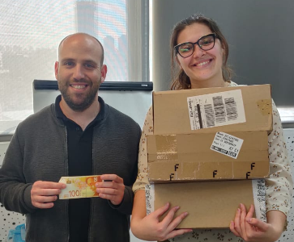
Virtual HUMINT Operation
Refund Fraud
Cyberint placed an undercover order for several items, and informed the retailer of the reference number. Both sides coordinated throughout the process and delivery stages, with the retailer changing the recipient address to the Cyberint offices only on the packages. Once the package arrived, Cyberint contacted “Asclepius” to initiate the refund request.
1
2
3
4
5
6
7
Argos™ Detection
Cyberint Alert & Op Approval
Building Fake Identity
Order Placement & Arrival
Fraudulent Refund Request
TTP & IOC Aggregation
Mitigation

Slide 30
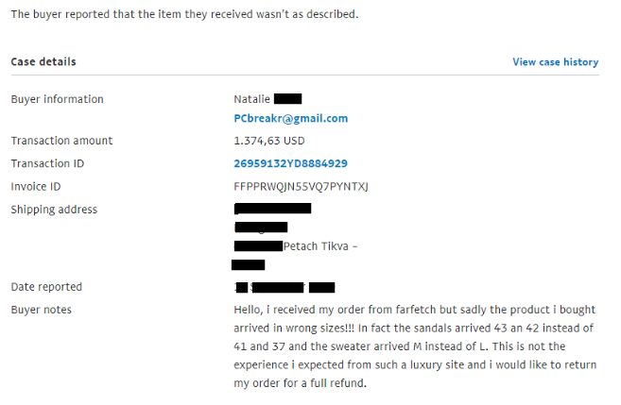
Virtual HUMINT Operation
Refund Fraud
Commission was set by the TA at 20% of the order, half was paid in advance. In order to request the fraudulent refund, “Asclepius” requested remote access to the Cyberint VM. Any suspicions here could cause the Threat Actor to abandon the operation. “Asclepius” remotely accessed and requested the refund via PayPal.
1
2
3
4
5
6
7
Argos™ Detection
Cyberint Alert & Op Approval
Building Fake Identity
Order Placement & Arrival
Fraudulent Refund Request
TTP & IOC Aggregation
Mitigation

Slide 31
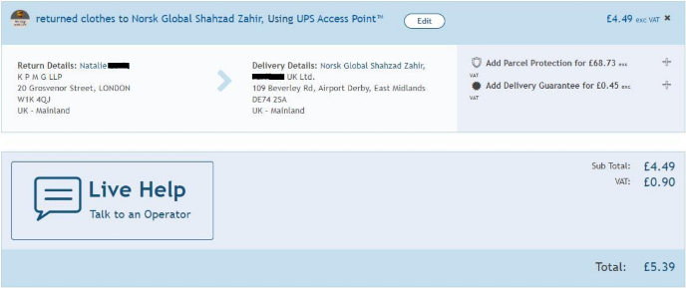
Virtual HUMINT Operation
Refund Fraud
The modus operandi for the TA appeared to be requesting the refund via PayPal claiming items were different sizes from the order. When PayPal asked for the goods to be returned, the TA selected a UPS drop-off point in London and left a package full of used clothes.
This TA’s MO was neutralized, and the retailer coordinated with PayPal to mitigate future similar fraud as well.
Retailer reduced refund scam by 90% within 1-year engagement.
1
2
3
4
5
6
7
Argos™ Detection
Cyberint Alert & Op Approval
Building Fake Identity
Order Placement & Arrival
Fraudulent Refund Request
TTP & IOC Aggregation
Mitigation

Slide 32
Threat Actor Profile Investigation
“Yhuricka Usuopmaki” - Threat Actor Targeting Philippine Banks

Slide 33
Threat Actor Investigation
Yhuricka Usuopmaki
Ongoing monitoring (since the end of 2018)
Deep-dive investigation
Collaboration with law enforcement

Slide 34
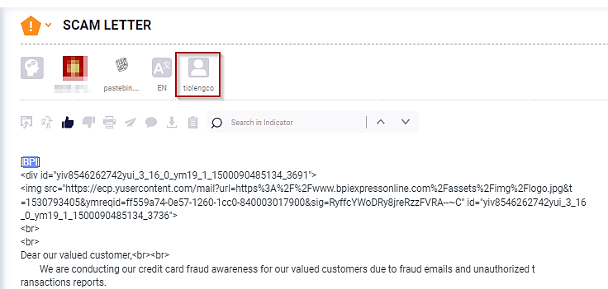
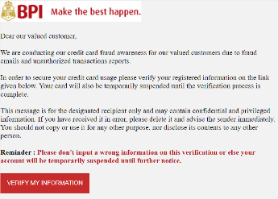
Threat Actor Investigation
Yhuricka Usuopmaki
On December 12, 2018, a Pastebin account with the username “tiolengco” published a phishing email template with a link to a phishing website which was active at the time of the detection, targeting a big Philippine bank
1
2
3
4
5
6
7
Argos™ Detection
Cyberint Alert
Request for Investigation
Uncover Real Identity
Ongoing Monitoring
Aggregated Evidence
Arrest

Slide 35
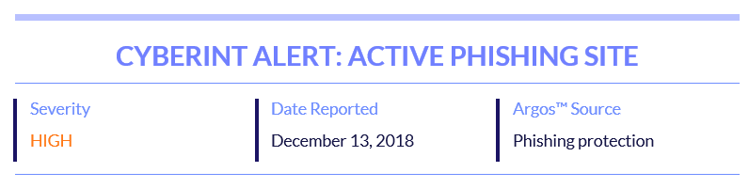
Threat Actor Investigation
Yhuricka Usuopmaki
On December 12, 2018, a Pastebin account with the username “tiolengco” published a phishing email template with a link to a phishing website which was active at the time of the detection, targeting a big Philippine bank
1
2
3
4
5
6
7
Argos™ Detection
Cyberint Alert
Request for Investigation
Uncover Real Identity
Ongoing Monitoring
Aggregated Evidence
Arrest

Slide 36
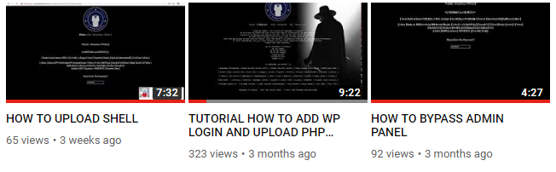
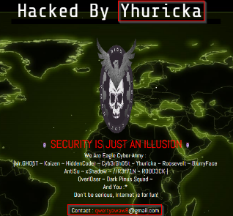
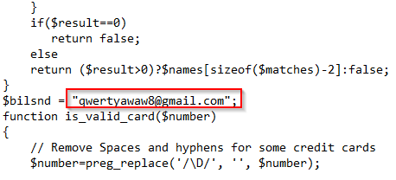
Threat Actor Investigation
Yhuricka Usuopmaki
The investigation revealed multiple details regarding the true identity of the TA behind the phishing activities, including his name, social media accounts and other aliases, as well as evidence of more malicious activities he has committed against financial institutions in the Philippines
1
2
3
4
5
6
7
Argos™ Detection
Cyberint Alert
Request for Investigation
Uncover Real Identity
Ongoing Monitoring
Aggregated Evidence
Arrest

Slide 37
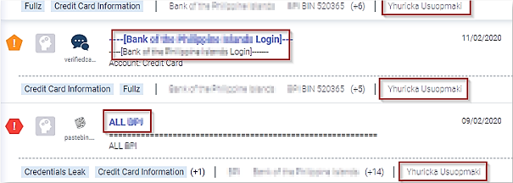
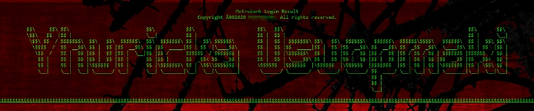

Threat Actor Investigation
Yhuricka Usuopmaki
Cyberint continued to monitor the threat actors activities via Argos™, and collect additional incriminating evidence against him over the time, as he continued targeting Philippine banks customers
1
2
3
4
5
6
7
Argos™ Detection
Cyberint Alert
Request for Investigation
Uncover Real Identity
Ongoing Monitoring
Aggregated Evidence
Arrest

Slide 38
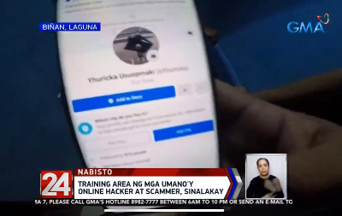
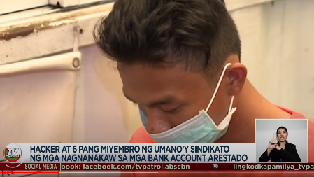
Threat Actor Investigation
Yhuricka Usuopmaki
The accumulating evidence and intelligence enabled filing a complaint against the threat actor, that led to his arrest on April 30, 2020. Currently there is a trial held against Fernando Tiolengco in the Philippines.
1
2
3
4
5
6
7
Argos™ Detection
Cyberint Alert
Request for Investigation
Uncover Real Identity
Ongoing Monitoring
Aggregated Evidence
Arrest

Slide 39





Thank You
www.cyberint.com

